Slide 1
B.Tech, Information Technology, 5th Sem, 3nd year
IT-502: Computer Network
Unit-2
Topic: Physical Addressing
Lecture No. 15
Jul –Dec, 2020
Nitin Dixit
Assistant Professor , Department of Computer Science & Engineering

Slide 2
Outlines
Introduction to Addressing
Types of Addressing
Physical or MAC Addressing
Format of MAC Addressing
Types of MAC Addressing
Mac Cloning
Learning Outcomes
Exercise on topic
References

Slide 3
Introduction to Addressing
In order to communicate or transfer the data from one computer to another computer we need some address. In Computer Network various types of address are introduced; each works at different layer. Media Access Control Address is a physical address which works at Data Link Layer.
SELO:9

Slide 4
Types of Addressing
Types of Addressing
IP Address
MAC or Physical Address
SELO:9

Slide 5
Physical or MAC Addressing
MAC Addresses are unique 48-bits hardware number of a computer, which is embedded into network card (known as Network Interface Card) during the time of manufacturing. MAC Address is also known as Physical Address of a network device.
Data Link Layer is divided into two sub layers –
Logical Link Control(LLC) Sublayer
Media Access Control(MAC) Sublayer
SELO:9

Slide 6
Format of MAC Addressing
MAC Address is a 12-digit hexadecimal number (6-Byte binary number), which is mostly represented by Colon-Hexadecimal notation. First 6-digits (say 00:40:96) of MAC Address identifies the manufacturer, called as OUI (Organizational Unique Identifier).
The rightmost six digits represents Network Interface Controller, which is assigned by manufacturer.
CC:46:D6 - Cisco
3C:5A:B4 - Google, Inc.
3C:D9:2B - Hewlett Packard
00:9A:CD - HUAWEI TECHNOLOGIES CO.,LTD
SELO:8
Source : www.geeksforgeeks.org

Slide 7
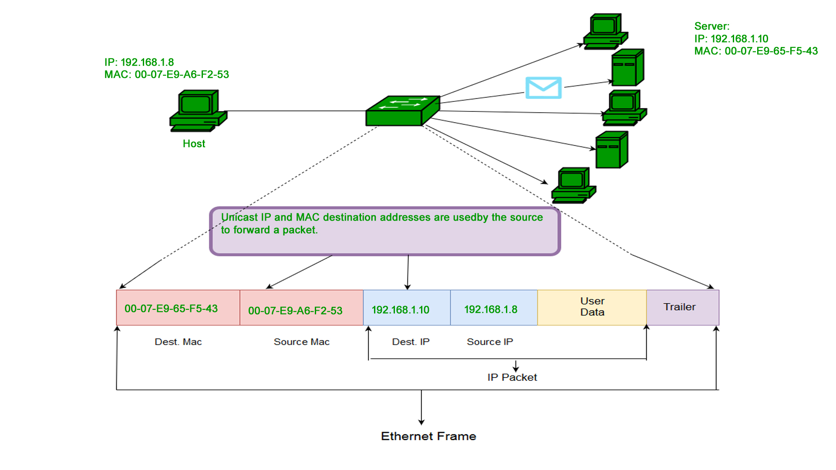
Types of MAC Addressing
Unicast
SELO:8
Source : www.geeksforgeeks.org

Slide 8
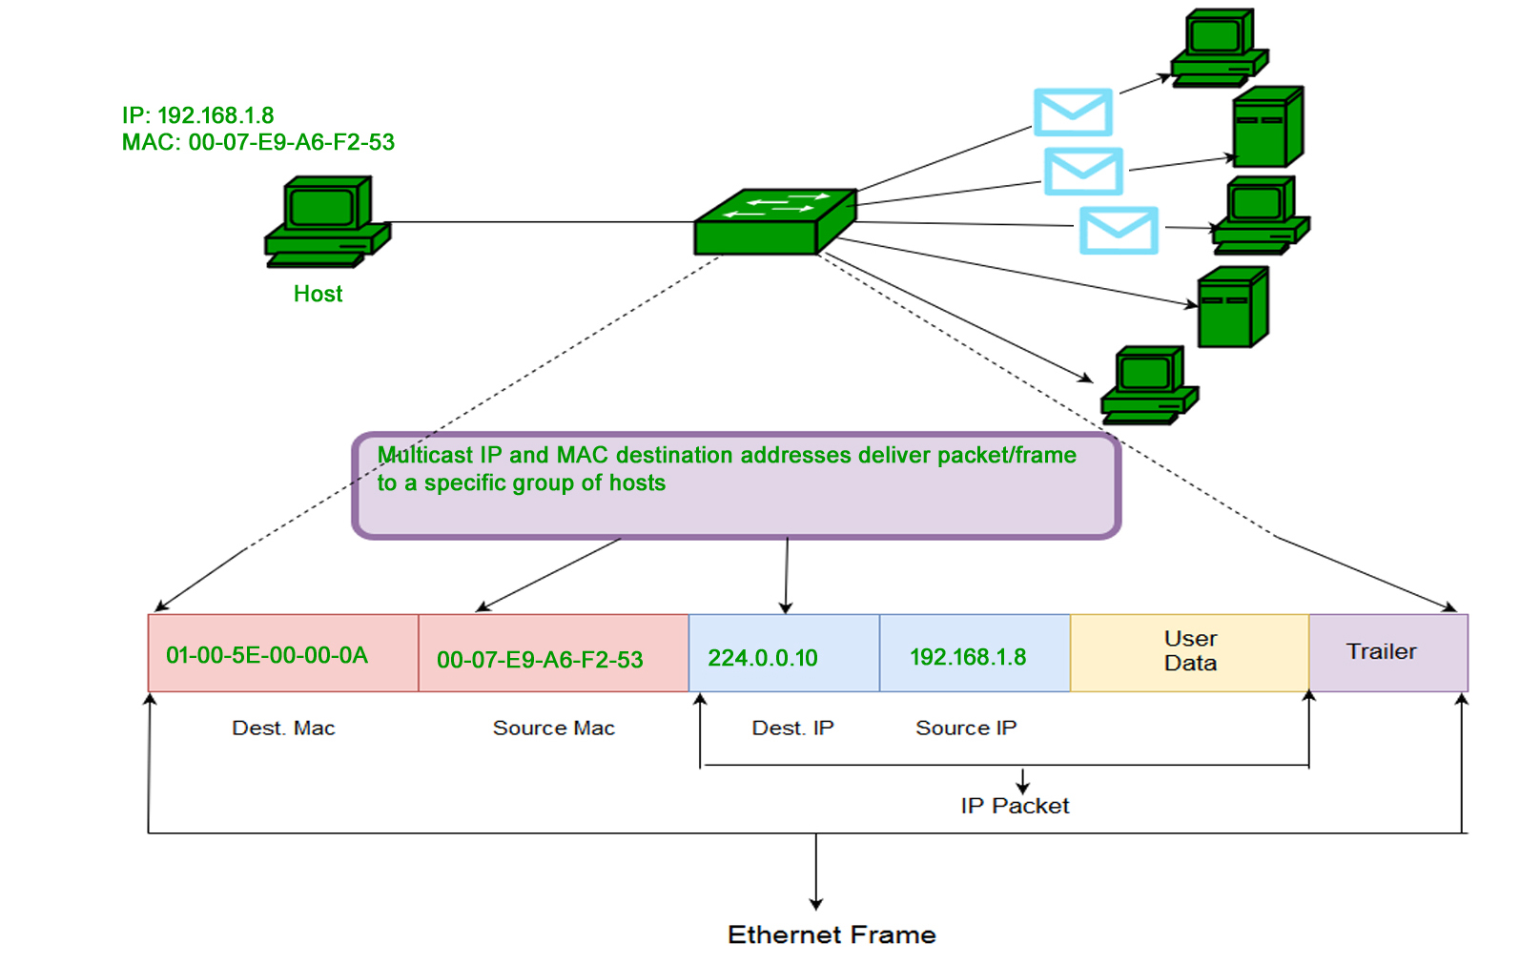
Multicast
SELO:8
Source : www.geeksforgeeks.org

Slide 9
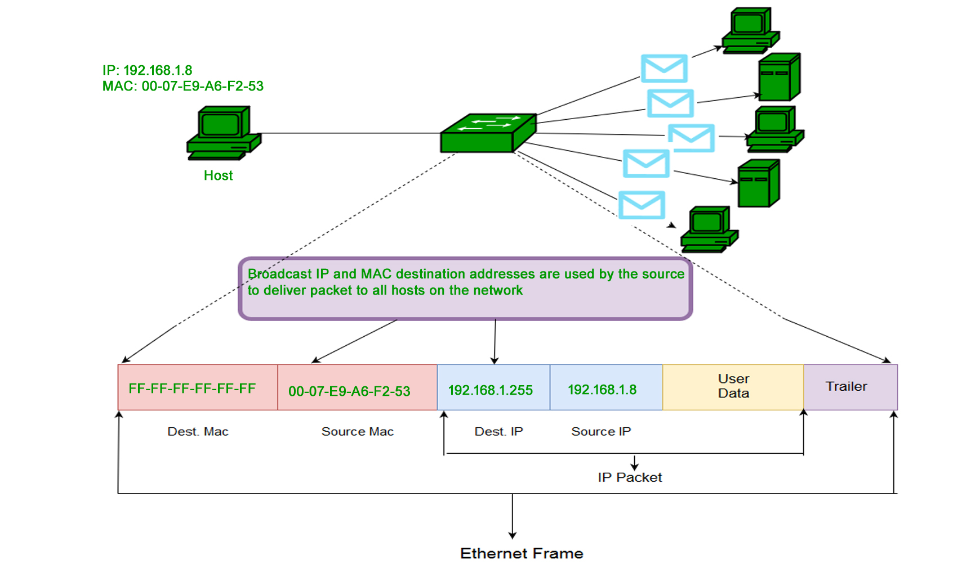
Broadcast
SELO:8
Source : www.geeksforgeeks.org

Slide 10
MAC Cloning
In cloning, user can simply clone the registered MAC address with ISP. Now router keeps reporting old MAC address to ISP and there will be no connection issue.
SELO:8

Slide 11
Learning Outcomes
What is MAC address?
Types of MAC address.
Why MAC address is important in networking?
What is MAC cloning?

Slide 12
Exercise
1. Hardware address is known as _________ a) MAC address b) IP Address c) Network Interface Card d) Address Resolution Protocol
2. What translates IP address into MAC address? a) Organizationally Unique Identifier b) Address Resolution Protocol c) Network Interface Card d) Burned In Address

Slide 13
3. MAC addresses are used as ________ a) Network addresses b) IP address c) Hardware address d) Burned in address
4. The original IEEE 802 MAC address comes from________ a) MAC address b) IP address c) Ethernet address d) Http

Slide 14
Reference and Text Books
Text Books
Data Communication & Networks, Fourouzan TMH
Reference Books
Computer Networks - Tanenbaum, PHI Learning
TCP/IP-Protocol suite - Forouzan, TMH 3rd edition

Slide 15
References
Data Communication & Networks, Fourouzan TMH
2. https://www.geeksforgeeks.org/

Slide 16


